Slide 1
Softeare and Software Engineering Activity 9: HTML

Slide 2
HTML Fundamentals
HTML

Slide 3


What is HTML?
HTML is a language for describing Web pages.
HTML stands for HyperText Markup Language.
HTML is not a programming language, it is markup language.
A markup language is a collection of markup tags.
HTML uses markup tags to describe Web pages.
HTML markup tags are usually called HTML tags or jut tags.
HTML tags are keywords surrounded by angle brackets.
HTML tags normally come in pairs, like <p> and </p>.
The first tag in a pair is the start tag; the second tag is the end tag.
Start and end tags are also called opening tags and closing tags.
HTML documents describe Web pages.
HTML documents contain HTML tags and plain text.
HTML documents are also called Web pages.

Slide 4

HTML Document Structure
<!DOCTYPE html>
<html>
<head>
<title>This is document title</title>
</head>
<body>
<h1>This is a heading</h1>
<p>Document content goes here.....</p>
</body>
</html>
Tag | Description
<!DOCTYPE> | This tag defines the document type and HTML version.
<html> | This tag encloses the complete HTML document and mainly comprises of document header and body.
<head> | This tag represents the document’s header which can keep other HTML tag.
<title> | The <title> tag is used inside the <head> tag to mention the document title.
<body> | The tag represents the document’s body which keep other HTML tags.

Slide 5
HTML – Basic Tags
Tag | Description | Tag
<a> | Defines a hyperlink | <ol> | Defines an ordered list
<b> | Defines bold text | <option> | Defines an option in a drop-down list
<br> | Defines a single line break | <pre> | Defines preformatted text
<button> | Defines a clickable button | <q> | Define a short quotation
<canvas> | Used to draw graphics (usually JavaScript) | <script> | Defines a client-side script
<div> | Defines a section in a document. | <section> | Defines a section in a document
<embed> | Defines a container for an external application. | <strong> | Define important text
<form> | Defines an HTML form for user input. | <style> | Define style information for a document
<h1> to <h6> | Defines HTML headings | <sub> | Defines subscripted text
<hr> | Defines a horizontal line | <sup> | Defines superscripted text
<iframe> | Defines an inline frame | <table> | Defines a table
<img> | Defines an image | <td> | Defines a cell in table
<input> | Defines an input control | <textarea> | Defines a multiple input control
<label> | Define a label for an <input> element | <th> | Defines a header cell in a table
<li> | Defines a list item | <tr> | Defines a row in a table
<link> | Defines an external resource. | <ul> | Defines a unordered list

Slide 6
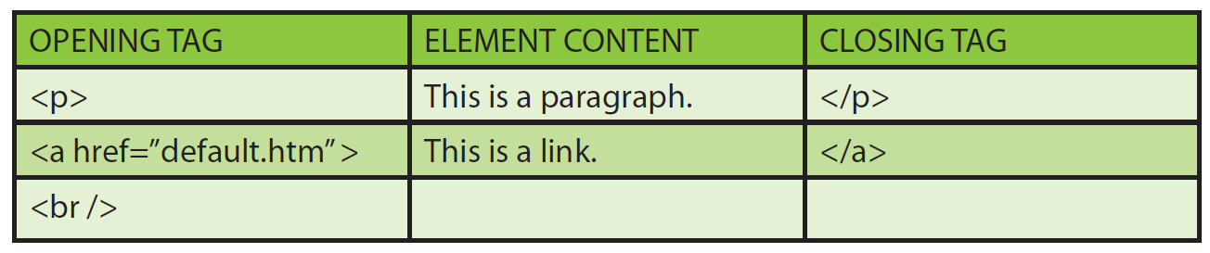
HTML Elements
HTML documents are defined by HTML elements.
A HTML element is everything between the start tag and the end tag.
HTML elements follow a certain format regardless of how the element is used.
An HTML element starts with a start tag/opening tag.
An HTML element ends with an end tag/closing tag.
The element content is everything between the start and the end tag.
Some HTML element have empty content.
Empty elements are closed in the start tag, like <br/>, <hr/>.
Most HTML elements can have attributes.

Slide 7
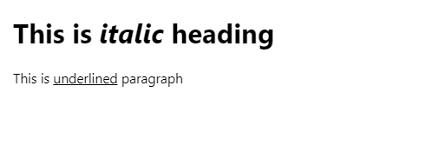
Nested HTML
<!DOCTYPE html>
<html>
<head>
<title>Nested Elements Example</title>
</head>
<body>
<h1>This is <i>italic</i> heading</h1>
<p>This is <u>underlined</u> paragraph</p>
</body>
</html>
Most HTML elements can be nested.
HTML documents consists of nested HTML elements.
The example shows that <i> element is nested in the <h1>, which in turn is nested in <body>.

Slide 8
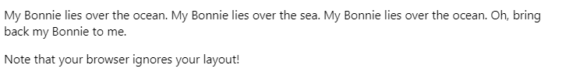
HTML Output
It is sometimes difficult to know how HTML will be displayed.
Large or small screens, different brands of browsers, and resized windows will create different results.
Adding extra spaces or extra lines in a HTML code will not change the output.
The browser will remove extra spaces and extra lines when the page is displayed.
Any number of lines count as one space, and any number of spaces count as one space.
<!DOCTYPE html>
<html>
<head>
<title>Output Example</title>
</head>
<body>
<p>
My Bonnie lies over the ocean.
My Bonnie lies over the sea.
My Bonnie lies over the ocean.
Oh, bring back my Bonnie to me.
</p>
<p>Note that your browser ignores your layout!</p>
</body>
</html>

Slide 9
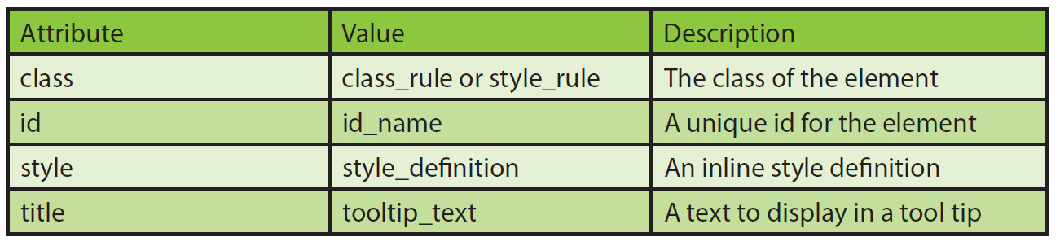
HTML Attributes
Attributes in HTML elements.
HTML elements can have attributes.
Attributes provide additional information about the element.
Attributes are always specified in the start tag.
Attributes come in name/value pairs like name=“value”.
The example shows that HTML links are defined with <a> tag.
The Web address, surrounded by quotation marks, is the value of the attributed of the link element.
Attribute names and values are not case sensitive. However, WWW Consortium recommends using lowercase attributes and values in its HTML .
<!DOCTYPE html>
<html>
<head>
<title>Link Example</title>
</head>
<body>
<a href="http://www.bbc.co.uk">This is a link to the BBC Web site.</a>
</body>
</html>

Slide 10
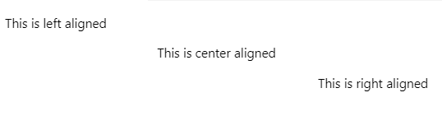
HTML – Align Attribute
<!DOCTYPE html>
<html>
<head>
<title>Align Attribute Example</title>
</head>
<body>
<p align="left">This is left aligned</p>
<p align="center">This is center aligned</p>
<p align="right">This is right aligned</p>
</body>
</html>
An attribute is used to define the characteristics of an HTML element and is placed inside the element’s opening tag.
All attributes are made up of two parts: a name and a value.
Three possible values of align attribute are used: left, center and right.

Slide 11
HTML Basic Tags
HTML

Slide 12
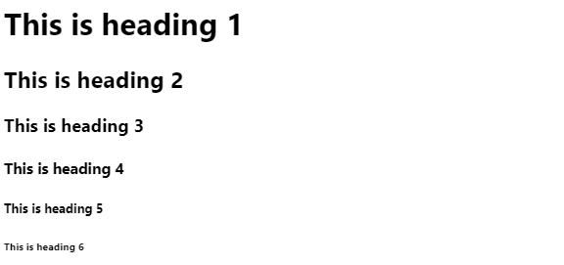
HTML – Heading Tag
<!DOCTYPE html>
<html>
<head>
<title>Heading Example</title>
</head>
<body>
<h1>This is heading 1</h1>
<h2>This is heading 2</h2>
<h3>This is heading 3</h3>
<h4>This is heading 4</h4>
<h5>This is heading 5</h5>
<h6>This is heading 6</h6>
</body>
</html>
HTML has six levels of headings, which use the elements <h1>, <h2>, <h3>, <h4>, <h5>, and <h6>.

Slide 13

HTML – Paragraph Tag
<!DOCTYPE html>
<html>
<head>
<title>Paragraph Example</title>
</head>
<body>
<p>Here is a first paragraph of text.</p>
<p>Here is a second paragraph of text.</p>
<p>Here is a third paragraph of text.</p>
</body>
</html>
The <p> tag offers a way to structure you text into different paragraphs.
Each paragraph of text should go in between an opening an <p> and a closing </p> tag.

Slide 14

HTML – Link Tag
<!DOCTYPE html>
<html>
<head>
<title>Link Example</title>
</head>
<body>
<a href="http://www.bbc.co.uk">This is a link to the BBC Web site.</a>
</body>
</html>
HTML links are defined with the <a> tag.
The URL address is an attribute of the link element using href.

Slide 15

HTML – Image Tag
<!DOCTYPE html>
<html>
<head>
<title>Link Example</title>
</head>
<body>
<img src="https://www.jaguarlandrover.com//themes/custom/jlr_corporate/images/corporate.png">
</body>
</html>
HTML images are defined with the <img> tag.
It tells the browser where to find the image file.

Slide 16

HTML – Line Break Tag
<!DOCTYPE html>
<html>
<head>
<title>Line Break Example</title>
</head>
<body>
<p>
Hello<br/>This is for testing line break.<br/>Thanks<br/>Young Saeng Park
</p>
</body>
</html>
HTML elements without content are called empty elements.
<br/> is an empty element without a closing tag.
It defines a line break.
The latest browsers will handle any way even though you miss the forward slash character <br> and you omit any space between the characters br and the forward slash <br/>.

Slide 17
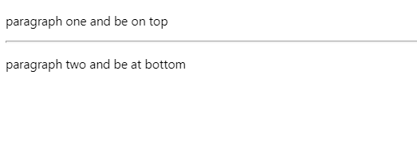
HTML – Horizontal Line Tag
<!DOCTYPE html>
<html>
<head>
<title>Horizontal Line Example</title>
</head>
<body>
<p>paragraph one and be on top</p>
<hr />
<p>paragraph two and be at bottom</p>
</body>
</html>
Horizontal line tag <hr /> is used to break up sections of a document.
<hr /> tag is an empty element where there is no need closing tag.
The latest browsers will handle any way even though you miss the forward slash character <hr> and you omit any space between the characters hr and the forward slash <hr/>.

Slide 18

HTML – Comment
<!DOCTYPE html>
<html>
<head>
<title>Heading Example</title>
</head>
<body>
<!-- <h1>This is heading 1</h1> -->
<h2>This is heading 2</h2>
<h3>This is heading 3</h3>
<!-- <h4>This is heading 4</h4> -->
<h5>This is heading 5</h5>
<h6>This is heading 6</h6>
</body>
</html>
Comments can be inserted in the HTML code to make readable and understandable.
Comments are ignored by the browser and are not displayed.

Slide 19
HTML Text Formatting
HTML

Slide 20
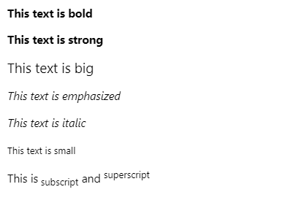
HTML – Text Formatting
<!DOCTYPE html>
<html>
<head>
<title>Formatting Example</title>
</head>
<body>
<p><b>This text is bold</b></p>
<p><strong>This text is strong</strong></p>
<p><big>This text is big</big></p>
<p><em>This text is emphasized</em></p>
<p><i>This text is italic</i></p>
<p><small>This text is small</small></p>
<p>This is<sub> subscript</sub> and <sup>superscript</sup></ p>
</body>
</html>
HTML uses tags like <b> and <i> to modify the appearance of text like bold or italic.
These HTML tags are called formatting tags.

Slide 21
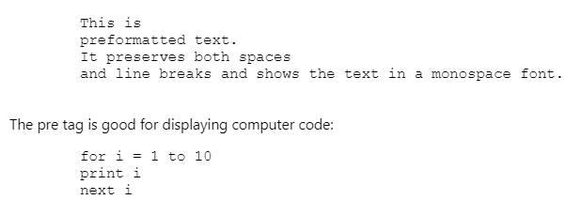
HTML – Preformatted Text
<!DOCTYPE html>
<html>
<head>
<title>preformatted Formatting Example</title>
</head>
<body>
<pre>
This is
preformatted text.
It preserves both spaces
and line breaks and shows the text in a monospace font.
</pre>
<p>The pre tag is good for displaying computer code:</p>
<pre>
for i = 1 to 10
print i
next i
</pre>
</body>
</html>
Any text between the <pre> tag and <pre/> tag will preserve the formatting of the source document.
The example demonstrates how you can control the line breaks, spaces, and character width with the <pre> tag.

Slide 22

HTML – Address Text
<!DOCTYPE html>
<html>
<head>
<title>Address Formatting Example</title>
</head>
<body>
<p>The addres of University of Warwick is::</p>
<address>
Univerisity of Warwick<br/>
Coventry,<br/>
CV4 7AL<br/>
United Kingdom
</address>
</body>
</html>
The example shows how to write an address in an HTML document.
It is the same as the <i> tag.

Slide 23
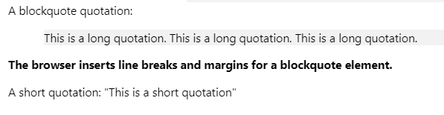
HTML – Quotation Text
<!DOCTYPE html>
<html>
<head>
<title>Text Quotation Example</title>
</head>
<body>
A blockquote quotation:
<blockquote>
This is a long quotation. This is a long quotation. This is a long quotation.
</blockquote>
<p><b>The browser inserts line breaks and margins for a
blockquote element.</b></p>
A short quotation:
<q>This is a short quotation</q>
</body>
</html>
This example demonstrates how to handle long and short quotations using <blockquote> and <q> tags.

Slide 24
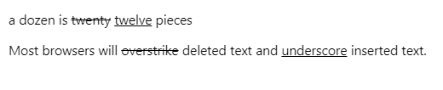
HTML – Deleted and Inserted Text
<!DOCTYPE html>
<html>
<head>
<title>Deleted & Inserted Example</title>
</head>
<body>
<p>
a dozen is
<del>twenty</del>
<ins>twelve</ins> pieces
</p>
<p>
Most browsers will <del>overstrike</del> deleted text and
<ins>underscore</ins> inserted text.
</p>
</body>
</html>
This example demonstrates how to mark a text that is deleted (strikethrough) or inserted (underscore) to a document using <del> and <ins> tags.

Slide 25
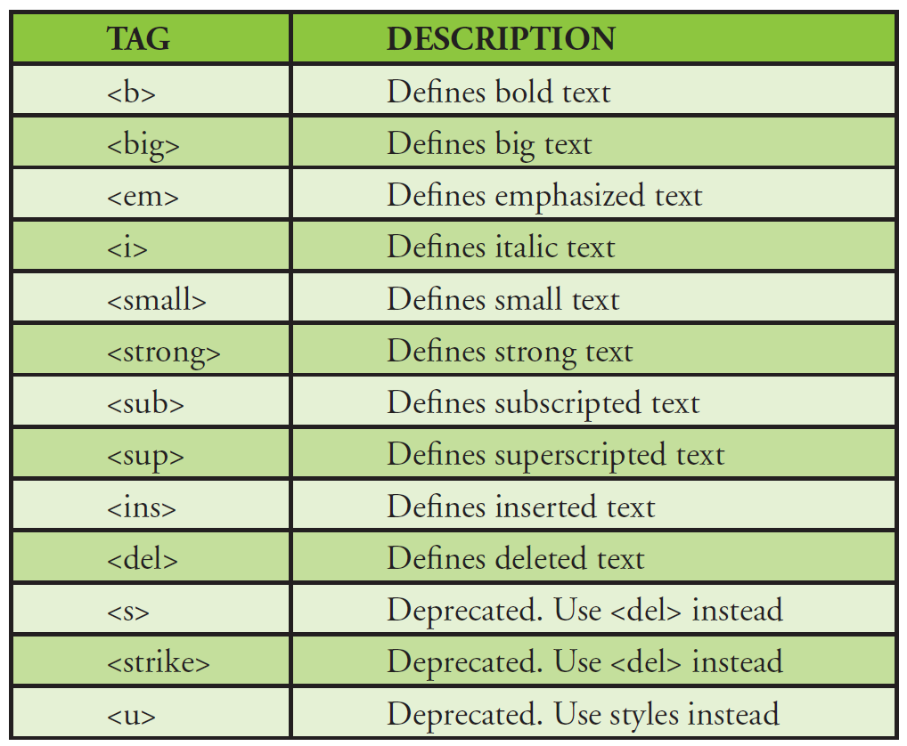
HTML – Text Formatting Tags
Many of these tags are either deprecated or soon will be.
Formatting with tags is very bad and should be done with CSS.

Slide 26
HTML Tables
HTML

Slide 27
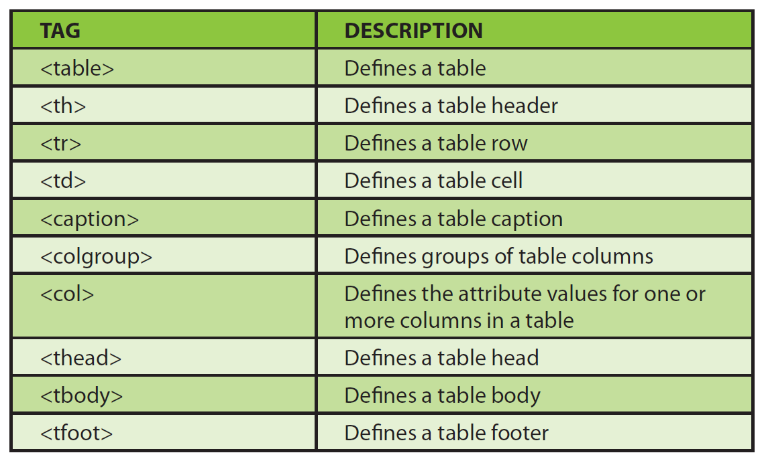
HTML Tables
Tables are an excellent way to organise and display information on Web pages.
Tables are defined using the <table> tag.
A table is divided into rows with the <tr> tag.
Each row is divided into data cells using the <td> tag.
A data cell can contain text, images, lists, paragraphs, forms, tables, and so on.
A basic table includes the following tags:
Each table starts with <table> tag.
Each table row starts with a <tr> tag.
Each table data (cell) starts with a <td> tag.

Slide 28
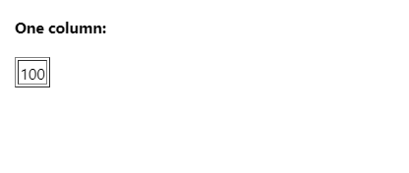
HTML – Simple Table
<!DOCTYPE html>
<html>
<head>
<title>Simple Table Example</title>
</head>
<body>
<h4>One column:</h4>
<table border="1">
<tr>
<td>100</td>
</tr>
</table>
</body>
</html>
This example demonstrates a table with one row and one column.

Slide 29
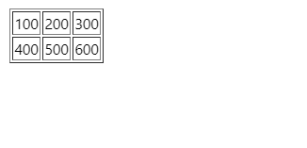
HTML – Two Rows and Three Columns Table
<!DOCTYPE html>
<html>
<head>
<title>Rows&Columns Table Example</title>
</head>
<body>
<table border="1">
<tr>
<td>100</td>
<td>200</td>
<td>300</td>
</tr>
<tr>
<td>400</td>
<td>500</td>
<td>600</td>
</tr>
</table>
</body>
</html>
This example demonstrates a table with two rows and three columns.

Slide 30
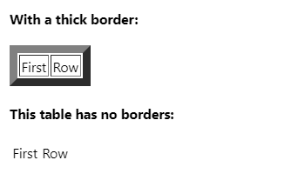
HTML – Table with Border
<!DOCTYPE html>
<html>
<body>
<h4>With a thick border:</h4>
<table border="8">
<tr>
<td>First</td>
<td>Row</td>
</tr>
</table>
<h4>This table has no borders:</h4>
<table>
<tr>
<td>First</td>
<td>Row</td>
</tr>
</table>
</body>
</html>
The border attribute controls the appearance of the table’s borders or lines.
The default border is 0 if you do not specify a border attribute.

Slide 31
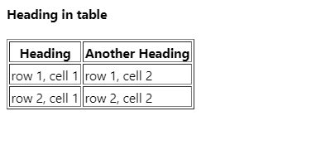
HTML – Table with Heading
<!DOCTYPE html>
<html>
<body>
<h4>Heading in table</h4>
<table border="1">
<tr>
<th>Heading</th>
<th>Another Heading</th>
</tr>
<tr>
<td>row 1, cell 1</td>
<td>row 1, cell 2</td>
</tr>
<tr>
<td>row 2, cell 1</td>
<td>row 2, cell 2</td>
</tr>
</table>
</body>
</html>
Table headings are defined with the <th> tag.
The headings are appeared in bold.

Slide 32
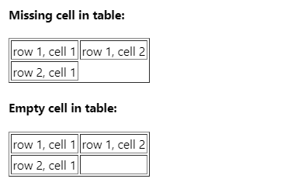
HTML – Table with Missing and Empty Cells
<!DOCTYPE html>
<html>
<body>
<h4>Missing cell in table:</h4>
<table border="1">
<tr>
<td>row 1, cell 1</td>
<td>row 1, cell 2</td>
</tr>
<tr>
<td>row 2, cell 1</td>
</tr>
</table>
<h4>Empty cell in table:</h4>
<table border="1">
<tr>
<td>row 1, cell 1</td>
<td>row 1, cell 2</td>
</tr>
<tr>
<td>row 2, cell 1</td>
<td>&nbsp;</td>
</tr>
</table>
</body>
</html>
The two tables show the difference of table shapes when missing a cell or not.

Slide 33
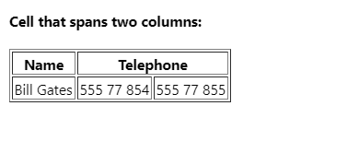
HTML – Table with Column Span
<!DOCTYPE html>
<html>
<body>
<h4>Cell that spans two columns:</h4>
<table border="1">
<tr>
<th>Name</th>
<th colspan="2">Telephone</th>
</tr>
<tr>
<td>Bill Gates</td>
<td>555 77 854</td>
<td>555 77 855</td>
</tr>
</table>
</body>
</html>
This example shows how to span more than one column.

Slide 34
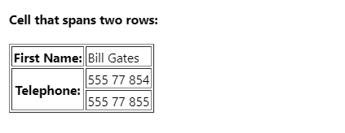
HTML – Table with Row Span
<!DOCTYPE html>
<html>
<body>
<h4>Cell that spans two rows:</h4>
<table border="1">
<tr>
<th>First Name:</th>
<td>Bill Gates</td>
</tr>
<tr>
<th rowspan="2">Telephone:</th>
<td>555 77 854</td>
</tr>
<tr>
<td>555 77 855</td>
</tr>
</table>
</body>
</html>
This example shows how to span more than one row.

Slide 35
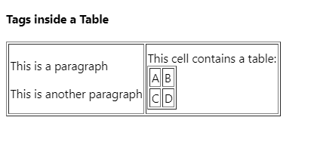
HTML – Tags Inside a Table
<!DOCTYPE html>
<html>
<body>
<h4>Tags inside a Table</h4>
<table border="1">
<tr>
<td>
<p>This is a paragraph</p>
<p>This is another paragraph</p>
</td>
<td>This cell contains a table:
<table border="1">
<tr>
<td>A</td>
<td>B</td>
</tr>
<tr>
<td>C</td>
<td>D</td>
</tr>
</table>
</td>
</tr>
</table>
</body>
</html>
This example shows how to display inside other elements.

Slide 36
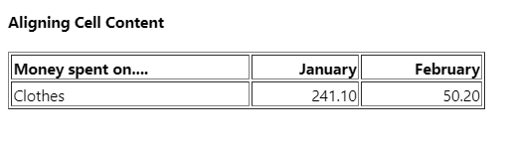
HTML – Aligning Cell Content in Table
<!DOCTYPE html>
<html>
<body>
<h4>Aligning Cell Content</h4>
<table width="400" border="1">
<tr>
<th align="left">Money spent on..</th>
<th align="right">January</th>
<th align="right">February</th>
</tr>
<tr>
<td align="left">Clothes</td>
<td align="right">241.10</td>
<td align="right">50.20</td>
</tr>
</table>
</body>
</html>
This example shows how to use the align attribute to align the content of cells to create a nicely organised table.

Slide 37
HTML Forms
HTML

Slide 38
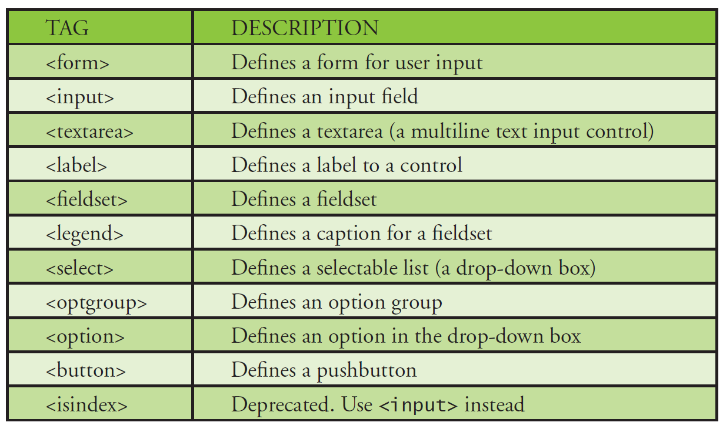
HTML Forms
HTML forms are used to collect different kinds of user input.
A form is an area that can contain form elements.
Form elements are elements that allow the user to enter information in a form.
The types of elements are: text fields, text area fields, drop-down menus, radio button, check boxes, and so on.
A form is defined with the <form> tag
<form>
…
Input elements
…
</form>

Slide 39
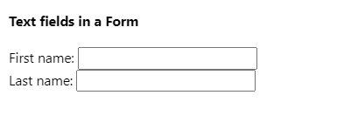
HTML – Form with Text Fields
<!DOCTYPE html>
<html>
<body>
<h4>Text fields in a Form</h4>
<form action="">
First name:
<input type="text" name="firstname" />
<br /> Last name:
<input type="text" name="lastname" />
</form>
</body>
</html>
Text fields are used when you want to the user to type letters, numbers, and so in a form.

Slide 40
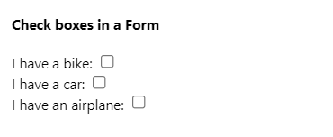
HTML – Form with Check Boxes
<!DOCTYPE html>
<html>
<body>
<h4>Check boxes in a Form</h4>
<form action="">
I have a bike:
<input type="checkbox" name="vehicle" value="Bike">
<br /> I have a car:
<input type="checkbox" name="vehicle" value="Car">
<br /> I have an airplane:
<input type="checkbox" name="vehicle" value="Airplane">
</form>
</body>
</html>
This example shows how to create check boxes on a HTML form, changing the value of type attribute to “checkbox”.

Slide 41
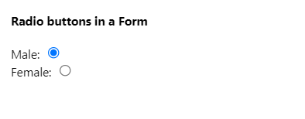
HTML – Form with Radio Buttons
<!DOCTYPE html>
<html>
<body>
<h4>Radio buttons in a Form</h4>
<form action="">
Male:
<input type="radio" checked="checked" name="Sex" value="male">
<br> Female:
<input type="radio" name="Sex" value="female">
</form>
</body>
</html>
This example shows how to create radio buttons on a HTML form, changing the value of type attribute to “radio”.
When a user clicks a radio button, that button becomes selected and all other buttons in the same group become deselected.

Slide 42
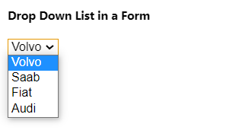
HTML – Form with Drop Down List
<!DOCTYPE html>
<html>
<body>
<h4>Drop Down List in a Form</h4>
<form action="">
<select name="cars">
<option value="volvo">Volvo</option>
<option value="saab">Saab</option>
<option value="fiat">Fiat</option>
<option value="audi">Audi</option>
</select>
</form>
</body>
</html>
This example demonstrates how to create a drop down list on a HTML form using <select> and <option> tags.
You can define a value preselected on the list using selected attribute such as
<option value=“fiat” selected>Fiat</option>

Slide 43
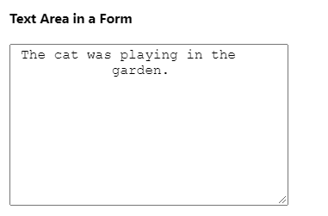
HTML – Form with Text Area
<!DOCTYPE html>
<html>
<body>
<h4>Text Area in a Form</h4>
<form action="">
<textarea rows="10" cols="30"> The cat was playing in the
garden.
</textarea>
</form>
</body>
</html>
Using a text area (a multiline text input control), you can write a unlimited number of characters.
A textarea can be in a form or elsewhere on a page.

Slide 44

HTML – Form with Buttons
<!DOCTYPE html>
<html>
<body>
<h4>Button in a Form</h4>
<form action="">
<form action="">
<input type="button" value="Hello world!">
</form>
</form>
</body>
</html>
Buttons are common items on a form.
The example shows how to create a button.
You can specify the own text on the face of the button using value attribute.

Slide 45
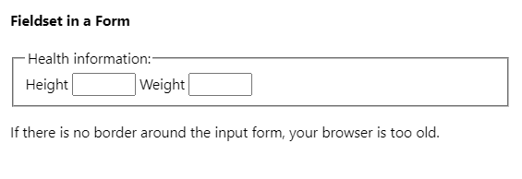
HTML – Form with Fieldset
<!DOCTYPE html>
<html>
<body>
<h4>Fieldset in a Form</h4>
<fieldset>
<legend>
Health information:
</legend>
<form action="">
Height <input type="text" size="3"> Weight <input type="text" size="3">
</form>
</fieldset>
<p>
If there is no border around the input form, your browser is too old.
</p>
</body>
</html>
A fieldset is a grouping of data fields.
The example shows how to draw a border with a caption around your data.

Slide 46
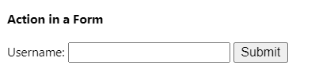
HTML – Form with Action Attribute
<!DOCTYPE html>
<html>
<body>
<h4>Action in a Form</h4>
<form name="input" action=“test.php" method="get">
Username:
<input type="text" name="user" />
<input type="submit" value="Submit" />
</form>
</body>
</html>
When a user clicks the Submit button, the content of the form is sent to the server.
The form’s action attribute define the name of the file to send the content to.
The file defined in the action attribute usually does something with input.
In the example, if you type some characters in the text field and click Submit button, the browser sends your input to a page called ‘test.php’.

Slide 47
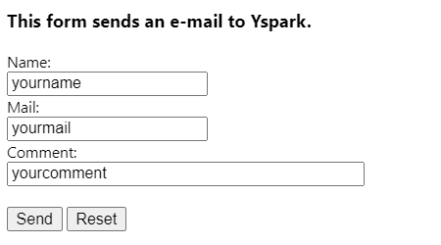
HTML – Form with Send E-Mail from a Form
<!DOCTYPE html>
<html>
<body>
<h4>Form Example</h4>
<form action=“sendmail.php" method="post" enctype="text/plain">
<h3>This form sends an e-mail to W3Schools.</h3>
Name:<br>
<input type="text" name="name" value="yourname" size="20">
<br> Mail:
<br>
<input type="text" name="mail" value="yourmail" size="20">
<br> Comment:
<br>
<input type="text" name="comment" value="yourcomment" size="40">
<br><br>
<input type="submit" value="Send">
<input type="reset" value="Reset">
</form>
</body>
</html>
This example demonstrates how to send name, mail, comment.
When clicking Send button, the ‘sendmail.php’ will be executed from a server.

Slide 48
HTML Lists
HTML

Slide 49
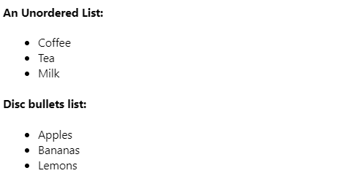
HTML – Unordered List and Different Bullets
<!DOCTYPE html>
<html>
<body>
<h4>An Unordered List:</h4>
<ul>
<li>Coffee</li>
<li>Tea</li>
<li>Milk</li>
</ul>
<h4>Disc bullets list:</h4>
<ul type="disc">
<li>Apples</li>
<li>Bananas</li>
<li>Lemons</li>
</ul>
</body>
</html>
An unordered starts with the <ul> tag.
Each list item start with the <li> tag.
Inside a list item, it is possible to put paragraphs, images, links, and so on.
You can display different kinds of bullets in an unordered list by using the type attribute.

Slide 50
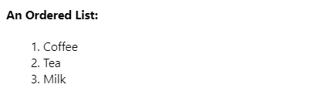
HTML – Ordered List
<!DOCTYPE html>
<html>
<body>
<h4>An Ordered List:</h4>
<ol>
<li>Coffee</li>
<li>Tea</li>
<li>Milk</li>
</ol>
</body>
</html>
It displays a list with ordered numbers.
The items are numbered sequentially rather than bulleted.
An ordered list starts with the <ol> tag.
Each list item starts with the <li> tag.

Slide 51
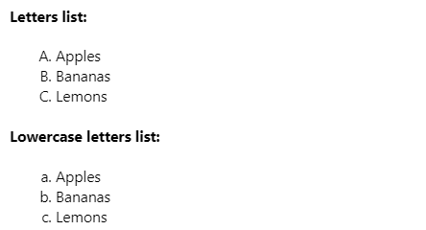
HTML – Ordered List with Different Types of Ordering
<!DOCTYPE html>
<html>
<body>
<h4>Letters list:</h4>
<ol type="A">
<li>Apples</li>
<li>Bananas</li>
<li>Lemons</li>
</ol>
<h4>Lowercase letters list:</h4>
<ol type="a">
<li>Apples</li>
<li>Bananas</li>
<li>Lemons</li>
</ol>
</body>
</html>
You can display different kinds of ordered lists by using the type attribute.
The example shows lists marked with uppercase and lowercase letters.

Slide 52
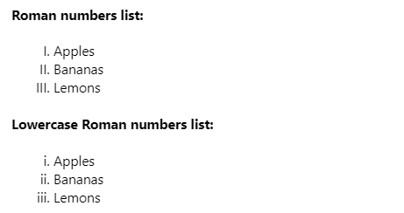
HTML – Ordered List with Different Types of Ordering
<!DOCTYPE html>
<html>
<body>
<h4>Roman numbers list:</h4>
<ol type="I">
<li>Apples</li>
<li>Bananas</li>
<li>Lemons</li>
</ol>
<h4>Lowercase Roman numbers list:</h4>
<ol type="i">
<li>Apples</li>
<li>Bananas</li>
<li>Lemons</li>
</ol>
</body>
</html>
You can display different kinds of ordered lists by using the type attribute.
The example shows lists marked with uppercase I and lowercase i letters.

Slide 53
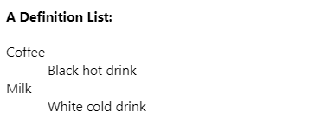
HTML – Definition Lists
<!DOCTYPE html>
<html>
<body>
<h4>A Definition List:</h4>
<dl>
<dt>Coffee</dt>
<dd>Black hot drink</dd>
<dt>Milk</dt>
<dd>White cold drink</dd>
</dl>
</body>
</html>
A definition list is not a list of single items. It is a list of items (terms), together with a description of each item (term).
A definition list starts with a <dl> tag (definition list).
Each term starts with a <dt> tag (definition term).
Each description starts with a <dd> tag (definition description).

Slide 54
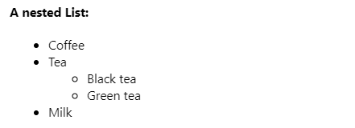
HTML – Nested Lists
<!DOCTYPE html>
<html>
<body>
<h4>A nested List:</h4>
<ul>
<li>Coffee</li>
<li>Tea
<ul>
<li>Black tea</li>
<li>Green tea</li>
</ul>
</li>
<li>Milk</li>
</ul>
</body>
</html>
A nested list is a list within another list.
The second list is indented another level and the item markers will appear differently than the original list.

Slide 55
HTML Images
HTML

Slide 56
HTML Images
Images are defined with the <img> tag.
The img tag is an empty element which it contains attributes only and it has no closing tag.
You need to use the src attribute to display an image.
src stands for “source”. The value of the src attribute is the URL of the image to display on a page.
The syntax of defining an image:
<img src=“url” />
The URL points to the location or address where the image is stored.
The example shows that the image file named “corporate.png” located in the directory “themes/custom/jlr_corporate/images/” on “www.jaguarlandrover.com”.
<!DOCTYPE html>
<html>
<body>
<img src=https://www.jaguarlandrover.com/themes/custom/jlr_corporate/images/corporate.png />
</body>
</html>

Slide 57

HTML – Images with Paragraph
<!DOCTYPE html>
<html>
<body>
<p>
An image:
<img src="https://www.jaguarlandrover.com/themes/custom/jlr_corporate/images/corporate.png">
</p>
</body>
</html>
The browser puts the image where the image tag occurs in the document.
If you put an image tag inside <p> tag, the browser shows a paragraph and then display the image next to the paragraph.

Slide 58

HTML – Background Image
<!DOCTYPE html>
<html>
<body background="background.jpg">
<h3>Look: A background image!</h3>
<p>Both gif and jpg files can be used as HTML backgrounds.</p>
<p>If the image is smaller than the page, the image will repeat itself.</p>
</body>
</html>
This example shows how to add a background image to an HTML page.
It uses the background attribute on <body> tag.

Slide 59
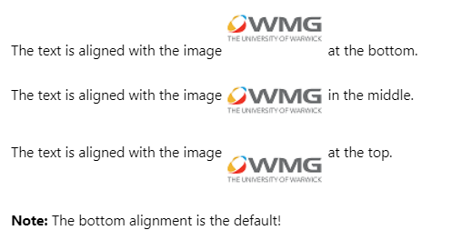
HTML – Aligning Images
<!DOCTYPE html>
<html>
<body>
<p>The text is aligned with the image
<img src="wmglogo.png" align="bottom" /> at the bottom.</p>
<p>The text is aligned with the image
<img src="wmglogo.png" align="middle" /> in the middle.</p>
<p>The text is aligned with the image
<img src="wmglogo.png" align="top" /> at the top.</p>
<p><b>Note:</b> The bottom alignment is the default!</p>
</body>
</html>
This example shows different ways to align images within the text.
It uses the align attribute to align the image.

Slide 60
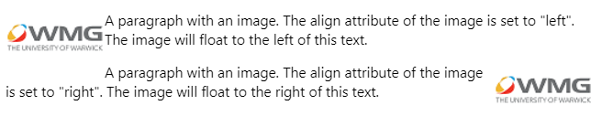
HTML – Floating Images
<!DOCTYPE html>
<html>
<body>
<p>
<img src="wmglogo.png" align="left" /> A paragraph with an image. The align attribute of the image is set to "left". The image will float to the left of this text.
</p>
<p>
<img src="wmglogo.png" align="right" /> A paragraph with an image. The align attribute of the image is set to "right". The image will float to the right of this text.
</p>
</body>
</html>
This example shows how to let an image float to the left or right of a paragraph.

Slide 61
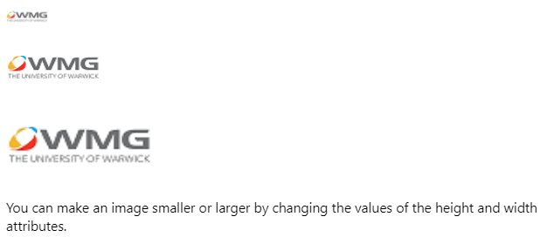
HTML – Adjusting Image Sizes
<!DOCTYPE html>
<html>
<body>
<p>
<img src="wmglogo.png" width="40" height="20" />
</p>
<p>
<img src="wmglogo.png" width="90" height="45" />
</p>
<p>
<img src="wmglogo.png" width="140" height="70" />
</p>
<p>You can make an image smaller or larger by changing the values of the height and width attributes.</p>
</body>
</html>
This example shows how to display images in different sizes.
The width and height attributes allow the page to render properly and more efficiently before the image is downloaded.
Make sure the ratio of image, otherwise it will not good appearance.

Slide 62

HTML – alt Attribute
<!DOCTYPE html>
<html>
<body>
<h4>WMG logo:</h4>
<img src="wmglogo1.png" alt="This is WMG logo" />
</body>
</html>
The alt attribute is used to define an alternative text for an image.
The alt attribute tells the reader what was missing a page if the browser cannot load images.
The browser will display the alternate text instead of the image.

Slide 63
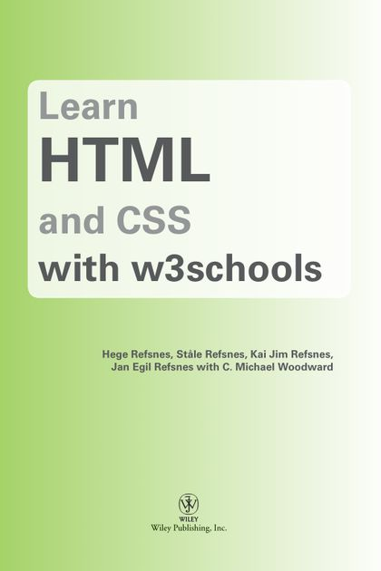
MAIN REFERENCE
GeeksforGeeks: https://www.geeksforgeeks.org/html-introduction/
freeCodeCamp: https://www.freecodecamp.org/news/html-basics-for-beginners/
HTML.COM: https://html.com/
SimpleHtmlGuide.com http://www.simplehtmlguide.com/cheatsheet.php
W3schools: https://www.w3schools.com/html/
HTML and CSS with w3chools
Hege Refsnes, Ståle Refsnes, Kai Jim Refsnes,
Jan Egil Refsnes with C. Michael Woodward
Sesson 1: HTML Basic

Slide 64
THANKS!
Q & A
Any questions?
y.s.park@warwick.ac.uk

